Slide 1


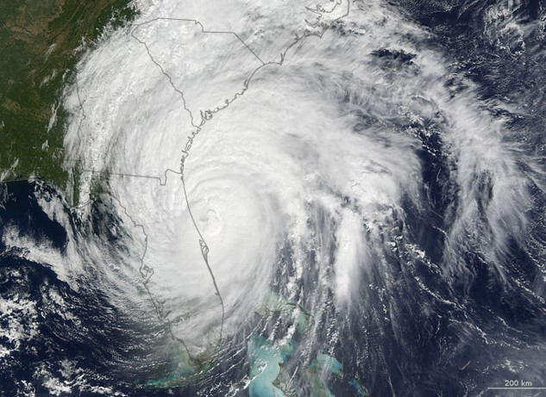
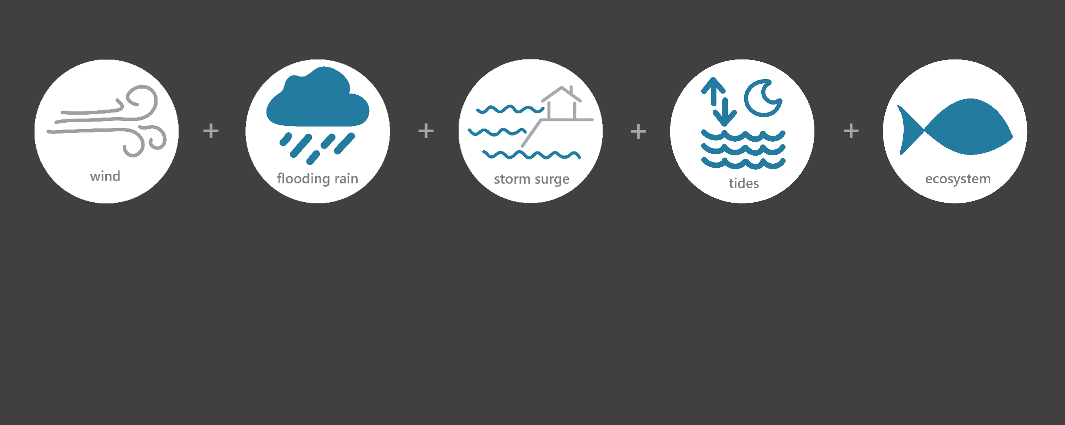

[ OCT 5 – OCT 10, 2016 ]
HURRICANE MATTHEW
1
Category
(very dangerous)
5.7
Inches of Rain
71
Miles per hour
of Max Wind Gusts
5.5
Feet of Storm Surge*
Monitoring the Impact of Hurricane Matthew at “North Inlet – Winyah Bay”
On October 8th, Hurricane Matthew moved parallel to the South Carolina coast as a category 1 hurricane until it made landfall about 25 miles south of Georgetown, South Carolina near McClellanville. Within a few hours, the center of the hurricane moved back offshore, but the large eyewall extended well inland and brought hurricane-force wind gusts and heavy rains to coastal regions of the Carolinas. The effects of Matthew were observed at the North Inlet –Winyah Bay (NIWB) Research Reserve through the System-Wide Monitoring Program (SWMP), which tracks short-term variability and long-term change in weather and water quality in the areas surrounding Georgetown, South Carolina.
Data shown are based on the NIWB weather monitoring site
*Oyster Landing NOS site
Created on May 27, 2022

Slide 2

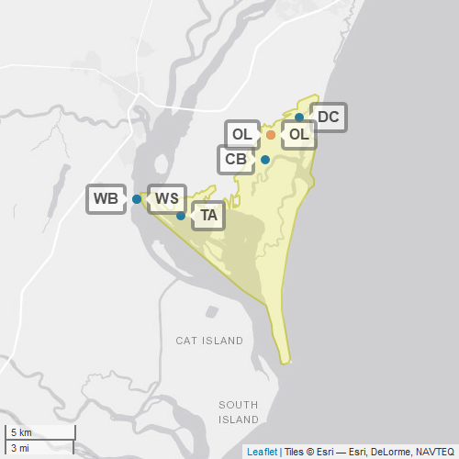
NIWB
North Inlet –Winyah Bay (NIWB) is one of 29 sites in the National Estuarine Research Reserve Systems (NERRS). Each site is a state-federal partnership that combines research, monitoring, and education to advance the understanding and management of estuarine environments.
NIWB
NERRS
Centralized Data
Management Office
NIWB Storm Monitoring
NIWB operates a weather station located in Oyster Landing (OL) and maintains six continuous, long-term water quality stations at Oyster Creek (OC), Debidue Creek (DC), Clambank (CB), Thousand Acre (TA), Winyah Bay Bottom (WB), and Winyah Bay Surface (WS) locations. NIWB is part of the SWMP. As Hurricane Matthew approached South Carolina, NIWB monitored the weather and water quality, collecting data every 15 minutes for the following parameters: air temperature, relative humidity, atmospheric pressure, rainfall, wind speed and direction, water temperature, depth, salinity, dissolved oxygen, turbidity, and pH.
Weather Station
Water Quality Sample Location

Slide 3
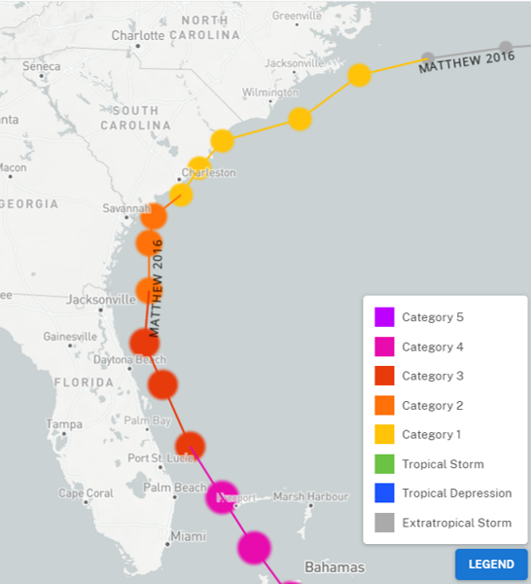
Matthew traveled along the Florida coast as a category 3 hurricane. Matthew weakened to a category 2 near the Georgia coast before transitioning to a category 1 near South Carolina. Matthew made landfall just south of McClellanville, South Carolina on October 8th.
More than 800,000 homes and businesses lost power across South Carolina.
Moderate flooding in the Black River and Pee Dee River spread into parts of the city of Georgetown and resulted in numerous evacuations throughout the county.
Source: https://oceanservice.noaa.gov/news/historical-hurricanes/
Matthew was a Category 1 on the Saffir–Simpson scale when it made landfall near McClellanville, SC. Matthew remained a Category 1 as it reached the NIWB reserve.
NIWB
NOAA NCEI estimates that wind and water damage totaled approximately $10 billion, making Matthew the 10th most destructive hurricane to affect the United States.
Aquatic life, like oysters, crabs, shrimp, fish, phytoplankton, etc. rely on specific levels of salinity and dissolved oxygen to thrive and survive. The weather impacts from Matthew caused significant drops in the levels of salinity and dissolved oxygen for varying periods of time, potentially stressing organisms.
Station | Date | Rainfall Total (in) | Rainfall Average Intensity (in/hr) | Wind Speed Max (mph) | Wind Speed Average (mph)
Oyster Landing | 10/6/2016 | 0.00 | 0.000 | 21.9 | 15.6
Oyster Landing | 10/7/2016 | 0.63 | 0.026 | 36.5 | 18.3
Oyster Landing | 10/8/2016 | 5.07 | 0.211 | 70.5 | 47.2
Oyster Landing | 10/9/2016 | 0.00 | 0.000 | 30.6 | 21.2
Oyster Landing | 10/10/2016 | 0.00 | 0.000 | 23.7 | 12.2
The highest local rainfall and wind measurements were recorded when Matthew approached NIWB on Oct. 8.
Data reporting time periods for Hurricane Matthew: 10/6/2016 - 10/10/2016

Slide 4
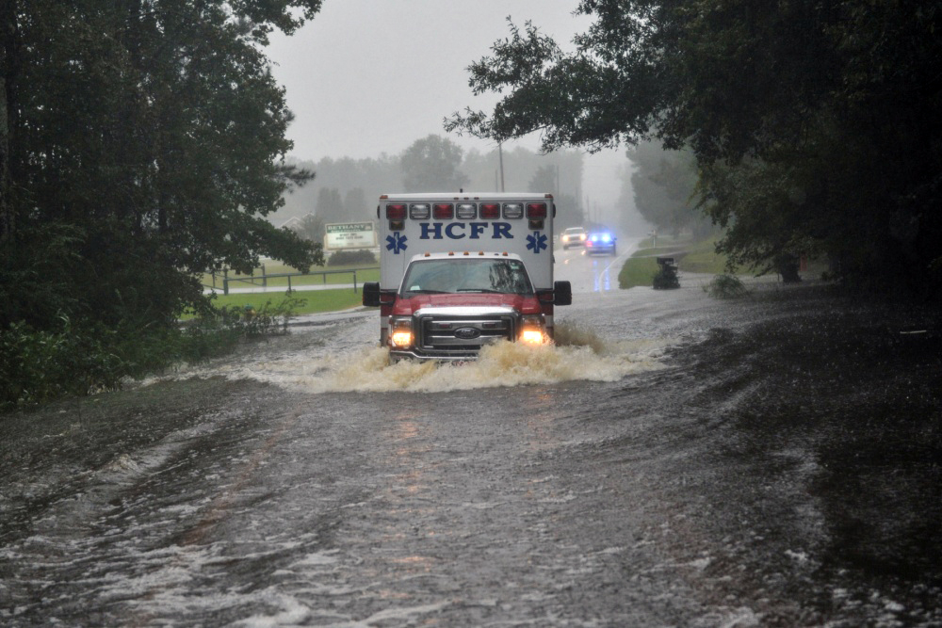
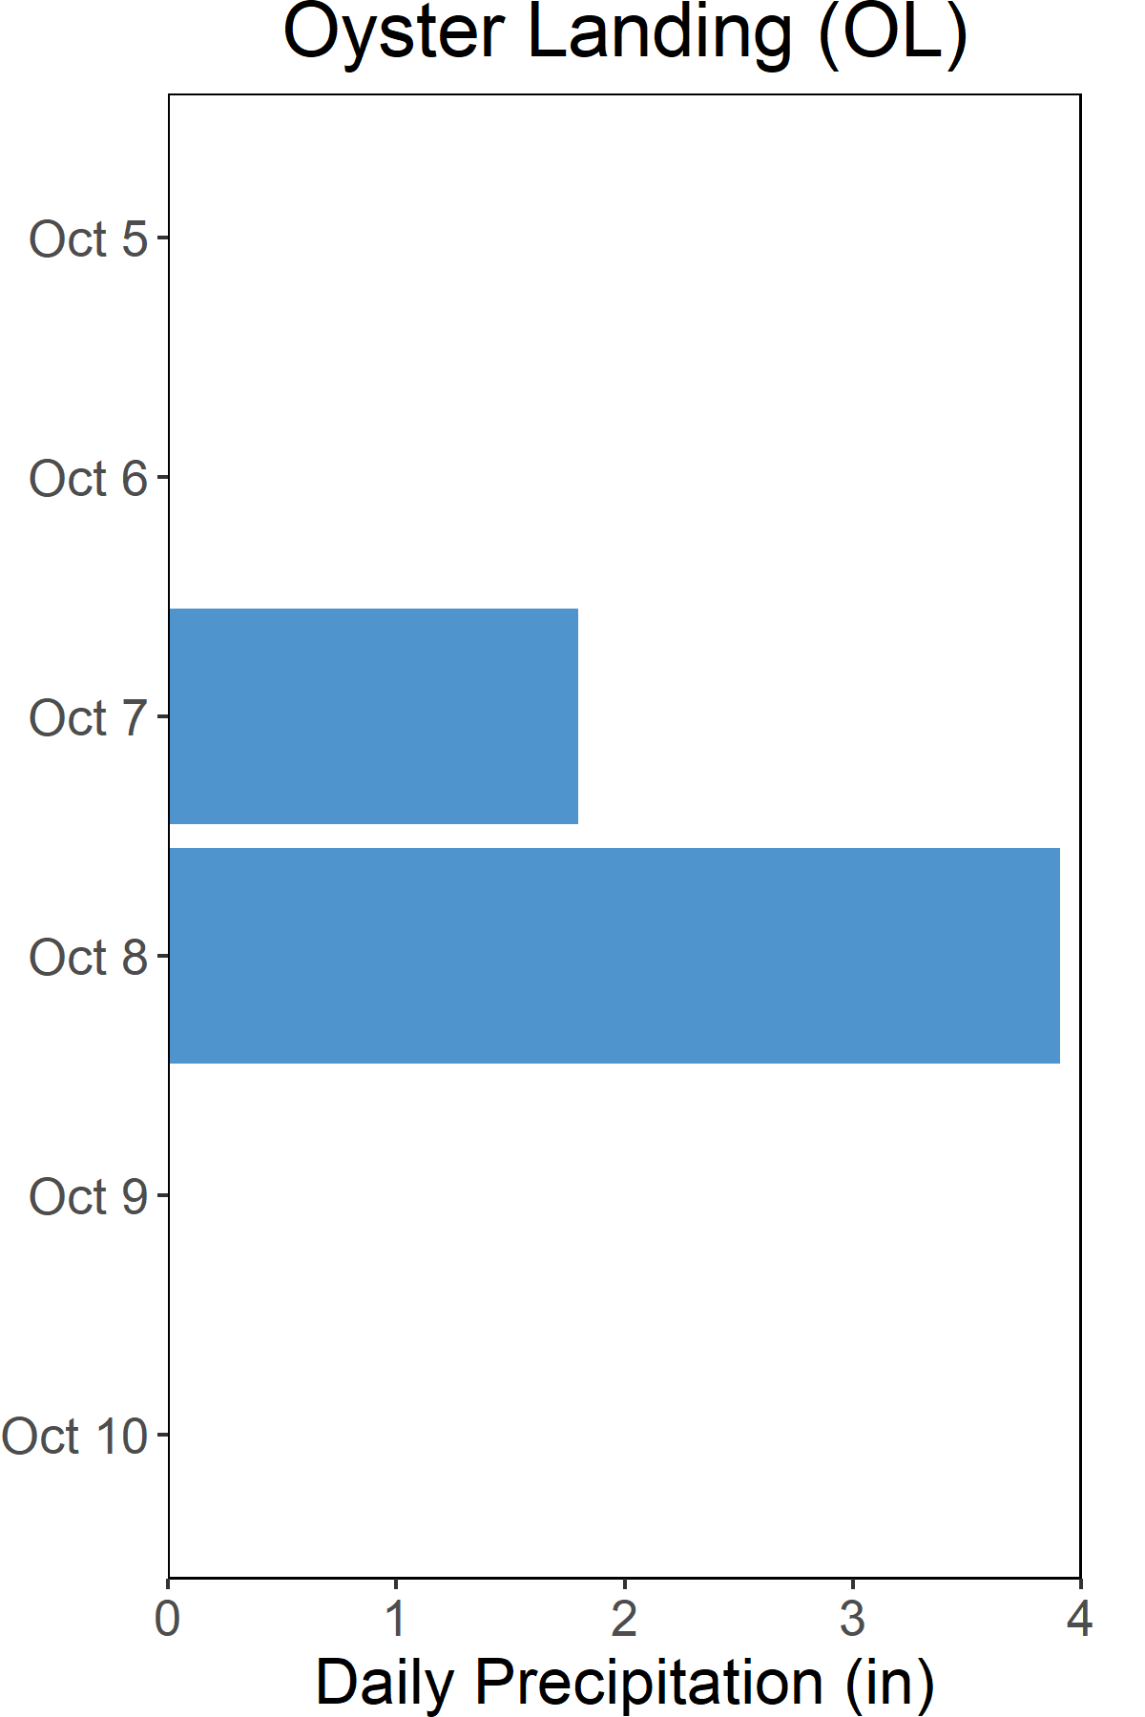

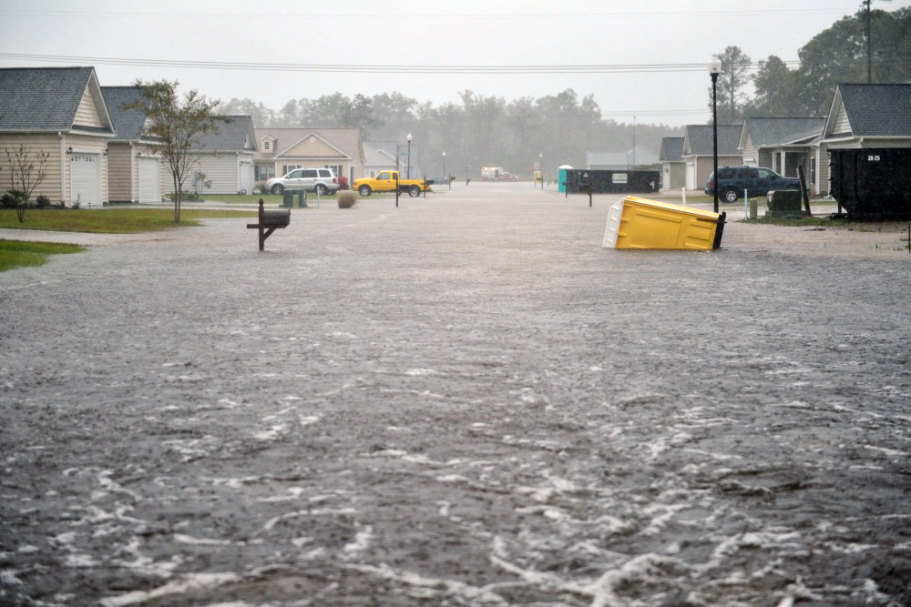
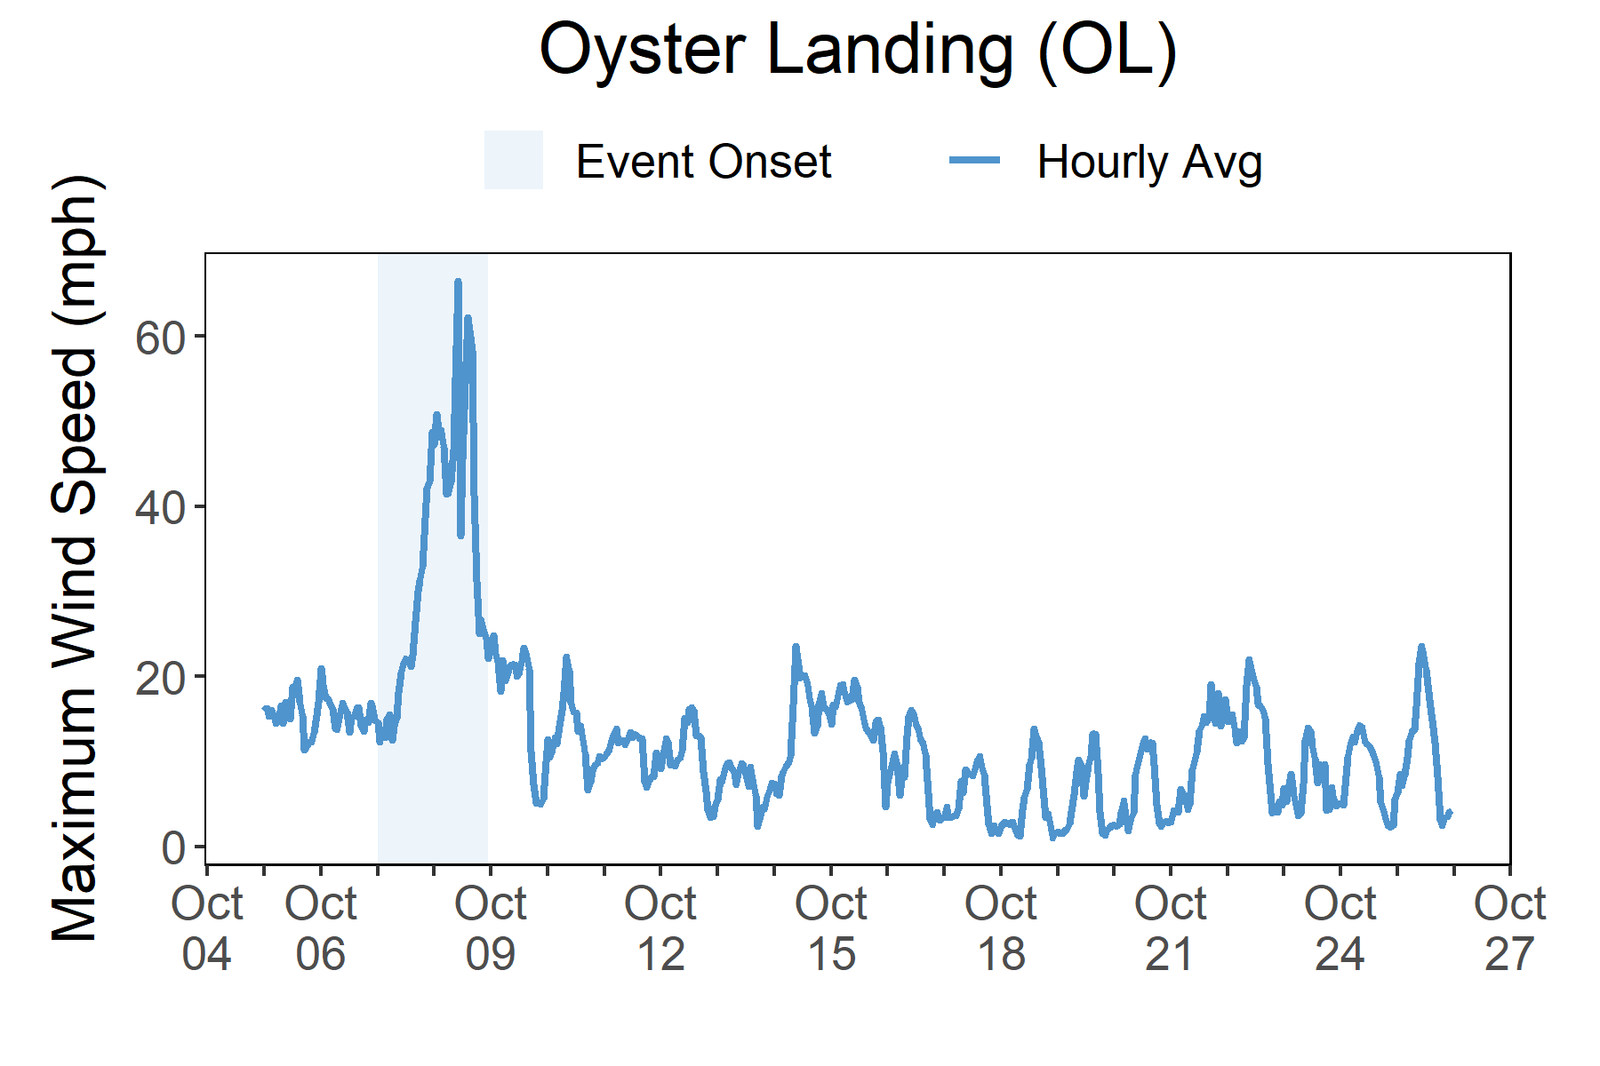

Rainfall
Matthew brought heavy rains, high winds, storm surge, and freshwater flooding to South Carolina.
A total of 5.7 inches of rainfall fell in the reserve area over the course of two days.
Torrential rains fell over South Carolina with 5.7 total inches of rainfall recorded at Oyster Landing over the course of two days. Hurricane-force wind gusts were felt in coastal areas. Massive wind speeds of up to 71 mph were measured at the reserve.
Maximum inundation levels across the state were 3-5 ft above ground level. At the NOS station at Oyster Landing, the peak water level was recorded at 4.7 ft above MHHW. In Georgetown County, moderate flooding occurred on the Black River and Pee Dee River and spread to parts of the city of Georgetown. Floodwaters caused numerous road closures plus downed trees and powerlines. In addition to Georgetown County, Beaufort, Berkely, Charleston, Dorchester, and Horry counties were also heavily damaged by Matthew. Across South Carolina, Matthew caused over a billion dollars in damage, left 800,000 people without electrical power, and caused significant environmental problems.
Daily Rainfall measurements at the weather station from Oct. 5 through Oct. 10.
Wind Speed
Max wind speed recorded at the reserve was 71 mph on Oct. 8
Maximum Wind Speed readings at the weather station from Oct. 5 through Oct. 26.

Slide 5
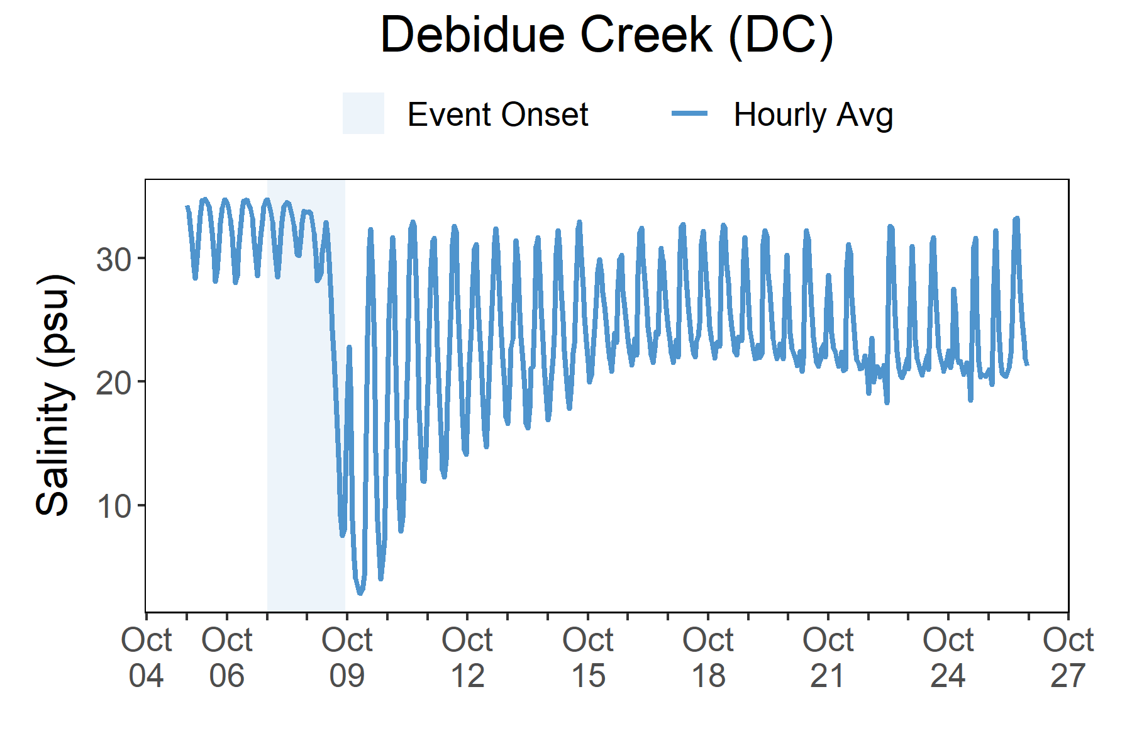
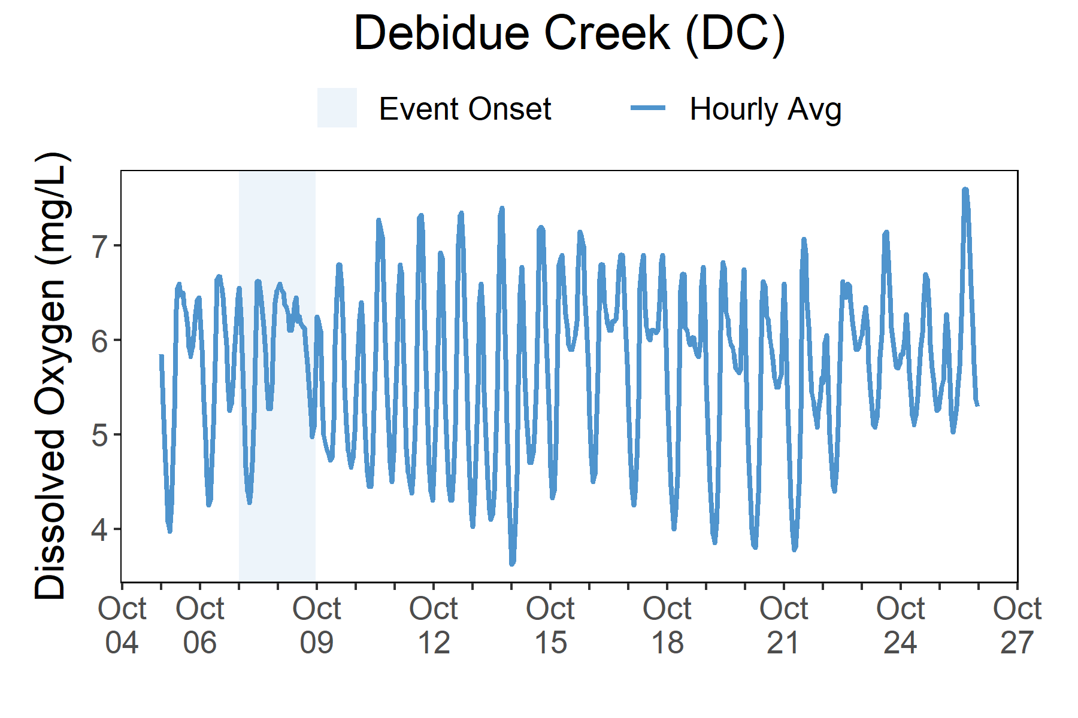
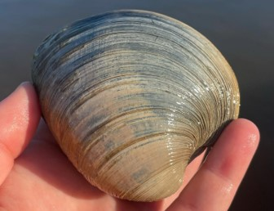
As Matthew traveled along the South Carolina coast on Oct. 8, salinity levels dropped and the diurnal cycle range narrowed for dissolved oxygen.
Station | Date | Depth Maximum (ft) | Salinity Minimum (psu) | Salinity Maximum (psu) | Dissolved Oxygen Minimum (mg/L) | Dissolved Oxygen Maximum (mg/L)
Debidue Creek | 10/6/2016 | 11.71 | 27.6 | 34.8 | 4.2 | 6.7
Debidue Creek | 10/7/2016 | 11.81 | 28.2 | 34.8 | 4.2 | 6.7
Debidue Creek | 10/8/2016 | 13.78 | 14.7 | 33.9 | 5.2 | 6.6
Debidue Creek | 10/9/2016 | 10.79 | 2.3 | 32.5 | 4.5 | 6.8
Debidue Creek | 10/10/2016 | 12.24 | 3.7 | 33.0 | 4.4 | 7.3
Data reporting time periods for Hurricane Matthew: 10/6/2016 - 10/10/2016
Salinity
Dissolved Oxygen
A rapid drop in salinity occurred as flooding
took place after Matthew
The regular diurnal cycle of dissolved oxygen was compressed at the onset of Matthew
Salinity levels from Oct. 5 through Oct. 26.
Dissolved Oxygen levels from Oct. 5 through Oct. 26.
Salinity and dissolved oxygen levels recorded at Debidue Creek show initial and post-storm impacts on water quality. For both parameters, the typical diurnal cycles were disturbed. For dissolved oxygen, the range in concentration was significantly smaller as Matthew traveled along the South Carolina coast on Oct. 8. For salinity, the daily minimum dropped dramatically as Matthew passed. Even after the storm, the salinity diurnal cycle recovered slowly. Major changes in salinity and dissolved oxygen can cause stress to some aquatic organisms depending on the species and how long the levels deviate from what is normal. Water quality stresses can impact survival and future populations.
Every plant and animal species have habitat preferences and requirements. Understanding these habitats is critical to understanding populations.

Slide 6
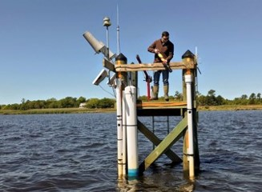
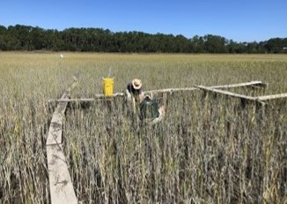

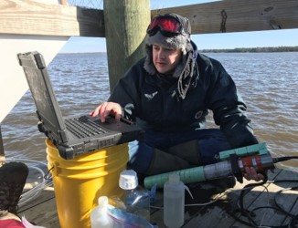
Maeve Snyder, Coastal Training Program Coordinator e: msnyder@baruch.sc.edu p: 843.904.9034
Visit www.nerrsdata.org to view and download weather and water quality data from North Inlet - Winyah Bay NERR.
Interested in learning more? Visit http://northinlet.sc.edu/. For video, news updates, online storm data and prediction visualization tools, check out our Storm Story Map at www.storm storymap.url.
@NIWBReserve

